Slide 1


Kai Schofield
09/28/2023

Slide 2

Outline
Executive Summary – slide 3
Introduction – slide 4
Methodology – slide 5-15
Results – slide 16-44
Conclusion – slide 45
Appendix – slide 46

Slide 3
Executive Summary
Using python, the data from SpaceX was collected, filtered, and pulled into a usable Pandas format.
Using mySQL and graphs, the data was explored before going into more detail with Folium, plotly Dash, and machine learning.
Several factors are key to a successful landing- location, payload mass, booster version, orbit, and an organization's technical expertise gained over time.

Slide 4
Introduction
Working for a new space launch company, what best practices could be used to compete with SpaceX?
Which factors best predict a successful landing, which dramatically saves on cost?
When creating our own rockets, what needs to be considered to maximize chances of our own landings?

Slide 5

Section 1

Slide 6
Methodology
Executive Summary
Data collection methodology:
Data was pulled from the SpaceX website and formatted for usability and focus
Perform data wrangling
Landing outcome was converted from categorical to Boolean for ease of use
Perform exploratory data analysis (EDA) using visualization and SQL
Perform interactive visual analytics using Folium and Plotly Dash
Perform predictive analysis using classification models
Using sklearn, several models were fit, transformed, and tested. Hyperparameters were automatically tested to select the best values for each model.

Slide 7
Data Collection
The requests library in python was used to connect with the SpaceX api and pull data from both Coursera and the SpaceX website
The initial Coursera dataset was first normalized, and additional data on booster versions, launch sites, payload, and cores was added to the resulting pandas dataframe directly from the SpaceX website.
This dataset was trimmed to focus on single core launches of the latest booster within a certain timeframe to limit focus and make insights easier to obtain.
Finally, missing payload values were replaced with the mean payload value

Slide 8
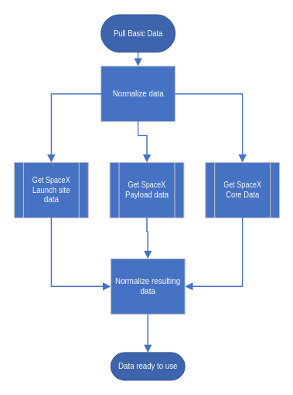
Data Collection – SpaceX API
Once an initial dataset was assembled from previously scraped data, the SpaceX api was called several times to get auxiliary data from several of their webpages.
The extra data collected includes booster names, launch site info, payload info, and secondary core characteristics
The jupyter notebook for data collection can be found on GitHub here

Slide 9
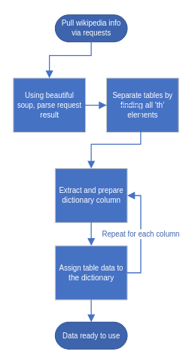
Data Collection - Scraping
Using requests and beautiful soup, the Wikipedia was scraped for its information on Falcon 9 launches
The resulting tables were parsed into a python dictionary for each type of data, with the results being collated into a pandas dataframe
Webscraping notebook can be found on GitHub here

Slide 10
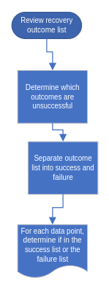
Data Wrangling
The spaceX dataset from the API was pre-processed for clarity
The number of launches per launch site and orbit were noted for future reference- these factors could potentially influence launch success
Landing outcomes were then separated into success and failure, so that future models may utilize a binary pass/fail metric.
GitHub URL for data wrangling is here

Slide 11
EDA with Data Visualization
Plotted the relationship between payload and launch site vs flight number, to see how these characteristics changed with each launch.
Separated launch sites to compare how the payloads are spread between launch sites and checked for orbit influences success rate.
Compared payload mass and flight number to orbit, with color based on success status, checking to see if success rate depends on these factors when combined with orbit. Noted that Polar, LEO, and ISS had superior landing rates for heavy payloads.
Finally, checked overall success rate over time- it has been increasing
Link to EDA notebook on github

Slide 12
EDA with SQL
The first several queries were highly exploratory and only really intended to get a grasp of the data represented in the table
The next two queries the sum of payload mass for all NASA launches, and the average Falcon 9 v1.1 payload mass.
Then queries found the first successful landing date and a list of Falcon 9 booster versions. This was followed with a count of successful and failed landings, and then a listing of versions which carried the maximum noted payload.
The final two queries listed the landing outcomes for 2015, followed by a ranked count of outcomes between 2010 and 2017.
The GitHub URL for EDA with SQL notebook is here

Slide 13
Build an Interactive Map with Folium
First, all launch sites were marked on a map, giving a visual representation of where the SpaceX launches have been occuring.
Then, the success and failures for each site were marked, showing where each outcome tends to occur in a visual manner
Finally, the distance between a launch site and nearby supported infrastructure was noted as this ease of access may have an impact of success rate
GitHub URL for the Folium map is here, but note that you may need to trust the notebook to have the folium maps show for you

Slide 14
Build a Dashboard with Plotly Dash
The dashboard shows two charts- a pie chart of success count by site, and a scatter chart that gives payload mass vs launch site, with success class colored for each instance.
The pie chart allows for easy comparison of success counts between launch sites and gives an idea of which sites have the most success.
The second chart allows for zeroing in on success rates for each site as determined by payload carried. The slider allows for fine-tuning of the visualization to focus on desired payload range.
When the two graphs are combined, a user can see how much of an overall site's success count is represented by a given payload range, and how the overall rate may change with differing payloads.
The GitHub for the plotly dashboard is here. As this is not a notebook, some work may be needed to visually see the outcome

Slide 15
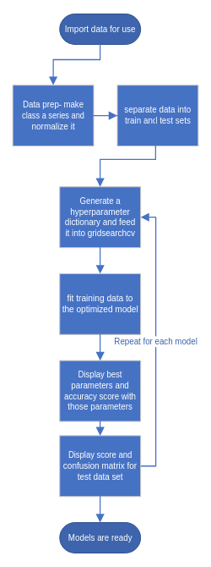
Predictive Analysis (Classification)
The sklearn library was used to generate models for various types of classification using a train/test data split of 80%/20%
The GridSearchCV method was used to determine the best hyperparameters for each model
Using accuracy score on both testing and training data, as well as a confusion matrix, allowed for quick comparison between models.
Ultimately, in what was probably user error each model had the same test score. However, the decision tree had the highest score for training data, and since is the one difference, decision tree is probably the best model.
Here is the lab- feel free to leave a commment about this issue

Slide 16
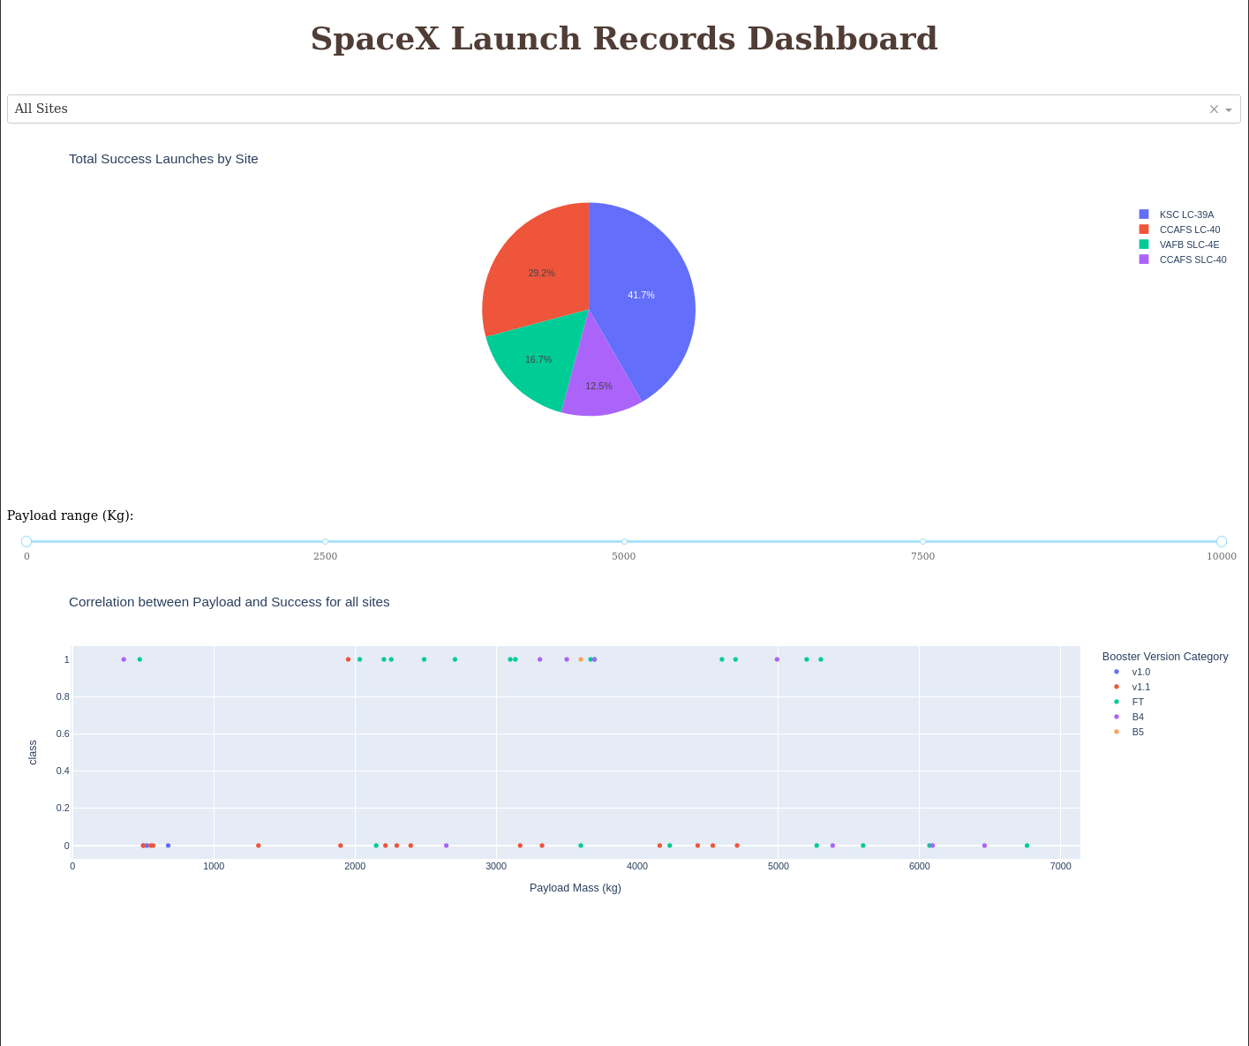
Results
Orbit, payload mass, and launch site are all predictors for a successful landing. The best orbits were ones where the orbit is highly circular and predictable, or ones where the satellite is easy to monitor (VLEO). The difference between PO and SSO, despite being ostensibly similar orbits, suggests regularity contributes to success rate. The flight number and time also corresponded to success, as experience with launches helps ensure a proper landing.
In the SQL data analysis, ground landings were more successful than ocean landings, and most launches were on the lighter end. Most launches during the observed time were lighter, likely due to cost and complication. The heavier payloads did still land frequently, so some other metric is likely why they are fewer in number.
To the right is a screenshot of the SpaceX launch records dashboard, which allows for easy visualization of total success launches by site, and correlation between payload and success for any or all site(s)
All the models appeared to operate similarly on the test data, though this may be user error. Of the tested models, the decision tree worked best of the training data.

Slide 17

Section 2

Slide 18
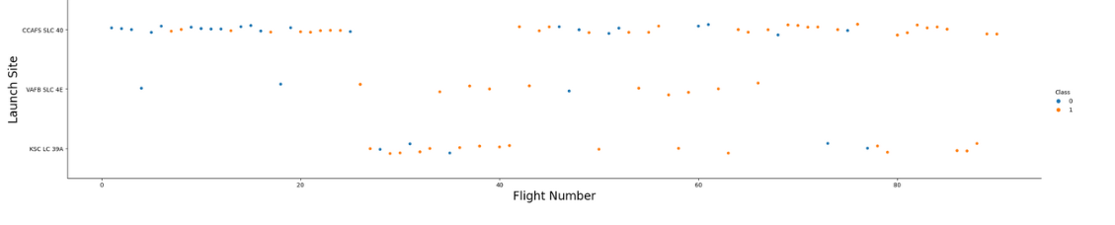
Flight Number vs. Launch Site
One launch site was largely used for early flights, before bringing up two more. The VAFB was no longer used after flight ~70, likely due to its location on the opposite side of the USA from the other two sites

Slide 19
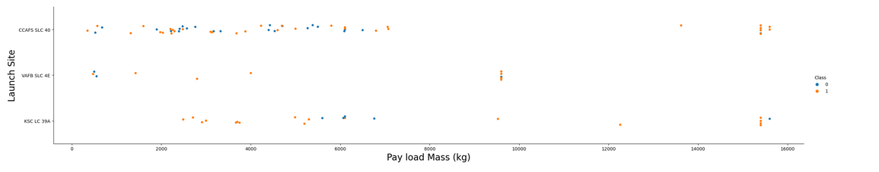
Payload vs. Launch Site
Certain launch sites have higher success rates, with high payloads showing a higher overall success rate.
Low to medium payloads have varying success rate, with every launch site holding a moderate success rate in this range.

Slide 20
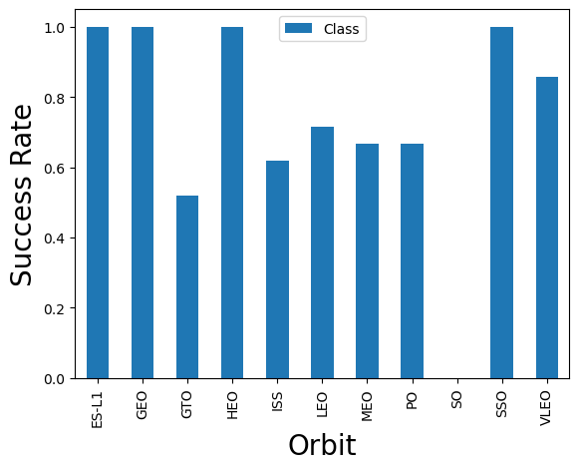
Success Rate vs. Orbit Type
Certain orbits are more elliptic or intermediate steps to a more stable, circular orbit.
The more circular and stable an orbit, the better the landing success rate. Many of the highest success rate orbits are synchronous.
Aside from these, lower orbits had higher success rates with LEO and VLEO beating the remaining orbits

Slide 21
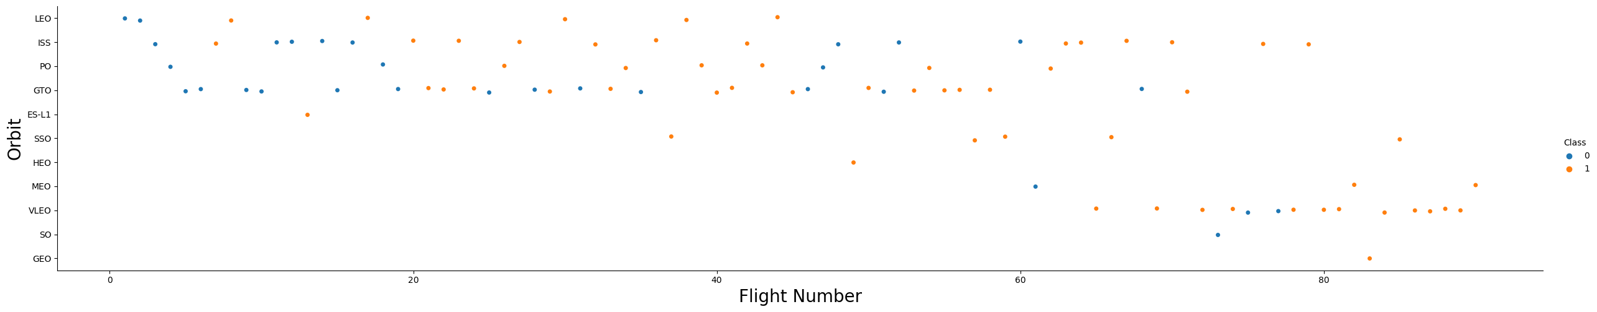
Flight Number vs. Orbit Type
Early orbits were among common satellite orbits and showed low success rate as initially landings were rare.
The highest success rates are among orbits that were not attempted until later in the program, and were attempted relatively few times.
Orbits attempted early on had higher failure rates, with failures decreasing over time.

Slide 22
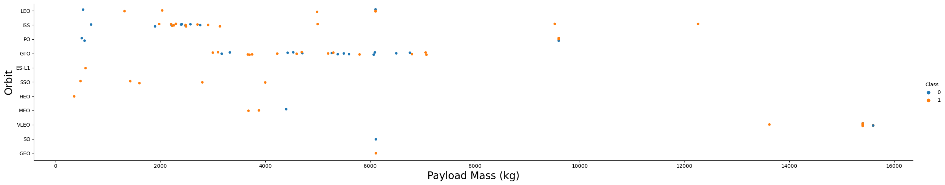
Payload vs. Orbit Type
Only certain orbits saw the highest payloads, namely in ISS and VLEO- both of which are low orbits and need less fuel to complete for a given payload.
Most orbits have a cluster of launches in a certain payload range that seems most common for that orbit.
Orbits have similar payloads show both success and failure, suggesting that payload isn't the strongest predictor for success.

Slide 23
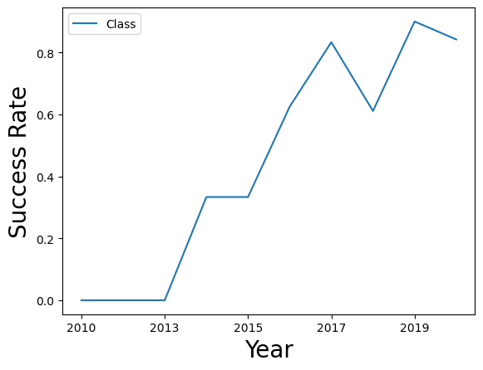
Launch Success Yearly Trend
Over time the success rate of landings has increased as a general trend.
The time periods of 2014-2015 and 2017-2018 are notable exceptions. Other factors temporarily disrupted this trend.

Slide 24
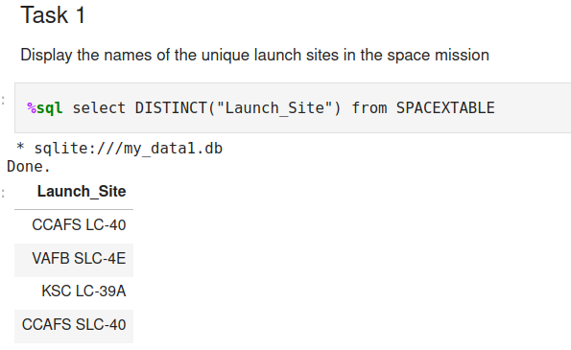
All Launch Site Names
The unique launch site names are CCAFS LC-40, VAFB SLC-4E, KSC LC-39A, and CCAFS SLC-40.
By selecting distinct launch sites we can quickly grab all unique names from the database.

Slide 25
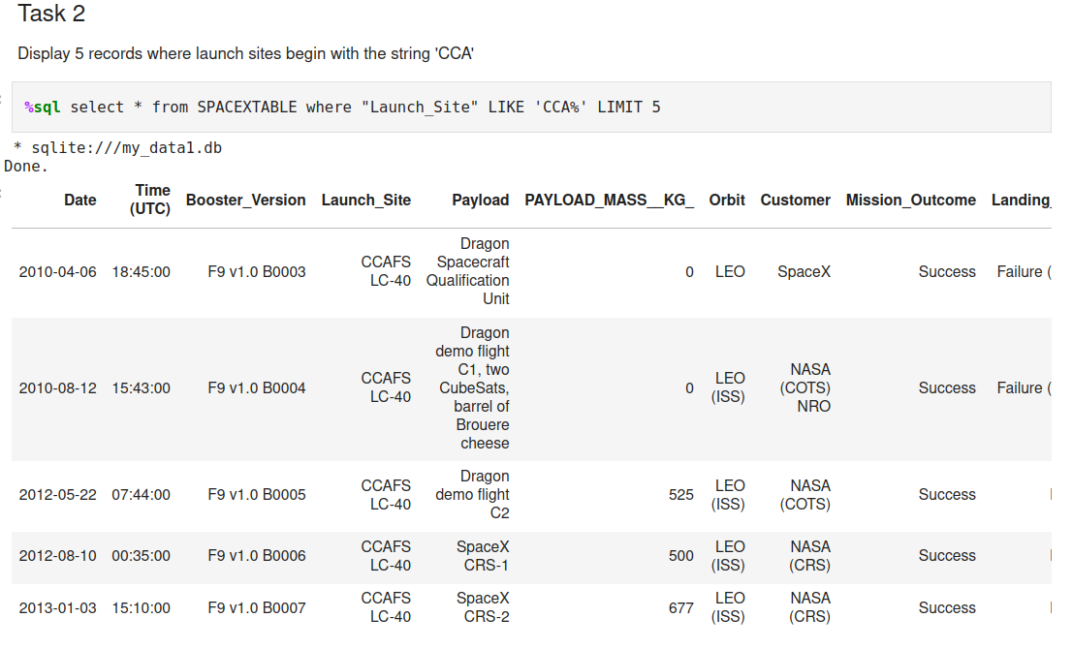
Launch Site Names Begin with 'CCA'
Selecting flights where the launch site is like CCA% asks for any launch site beginning with CCA, but allowing for anything to come after.
This query would show the results of both CCAFS LC-40 and CCAFS SLC-40, but for ease of presentation only the first 5 results are shown here.

Slide 26
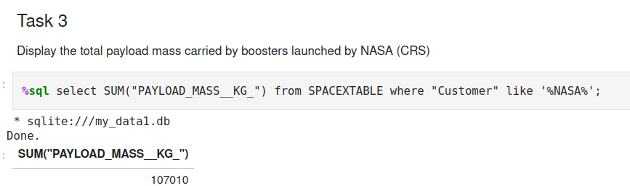
Total Payload Mass
The total payload carried by boosters on behalf of NASA was 107,010 kg.
By filtering the table to only take customers with NASA in the name, all launches on behalf of NASA were queried.
The result of the where clause had all payload masses summed to obtain this result

Slide 27
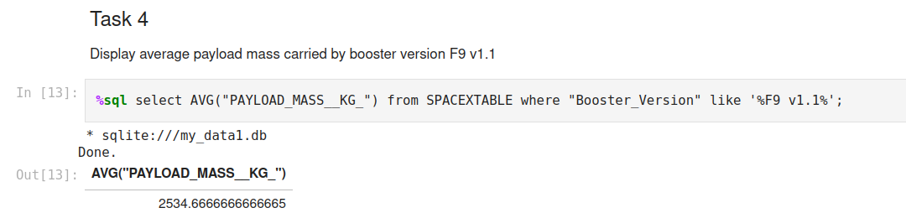
Average Payload Mass by F9 v1.1
The average payload mass for F9 v1.1 boosters was 2534.667 kg.
Using a where clause, we limit booster versions to any containing the phrase F9 v1.1
We then average the payload mass kg column using the AVG function.

Slide 28
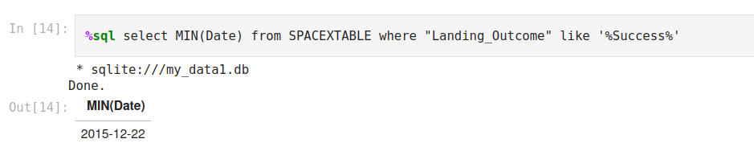
First Successful Ground Landing Date
By querying the minimum (earliest) date where landing outcome contained the word success, the first landing was found to occur on December 12th, 2015.

Slide 29
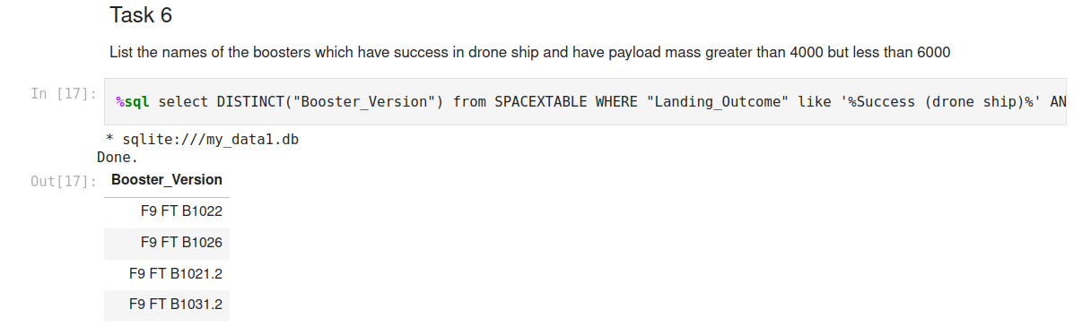
Successful Drone Ship Landing with Payload between 4000 and 6000
The list of boosters which have landed on a drone ship with a payload above 4000 and less than 6000 is F9 FT B1022, F9 FT B1026, F9 FT B1021.2, and F9 FT B1031.2.
This was found by querying for distinct booster versions where the landing outcome was successful on a droneship and the payload mass was in the correct range.

Slide 30
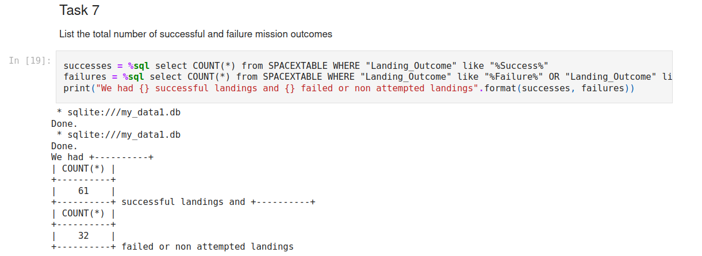
Total Number of Successful and Failure Mission Outcomes
There were 61 successful landings and 32 failures. Using SQL, successful landings were outcomes that contained the word success. Failures were defined as failure or no attempt, since both instances lead to a non landing event.

Slide 31
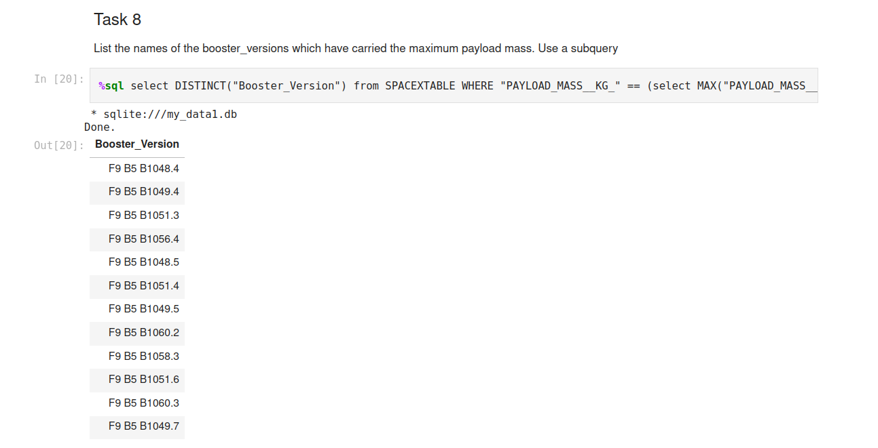
Boosters Carried Maximum Payload
Twelve separate boosters have carried the maximum payload mass, as visible on the left. All of them are F9 B9 rockets of varying versions.
The query to obtain this list selected boosters used in launches where their mass was equal to the mass payload, as found via subquery.

Slide 32
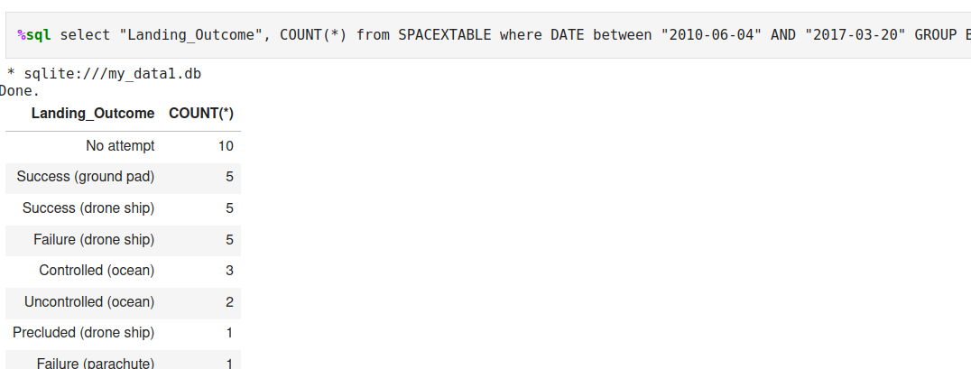
Rank Landing Outcomes Between 2010-06-04 and 2017-03-20
The landing outcomes in the selected time range are presented in descending order above, from the most common outcome of No attempt to the least common of failure (parachute).
The query is cut off above, but involves selecting landing outcome and count between two dates and grouping by landing outcome. The results are ordered by descending count.

Slide 33
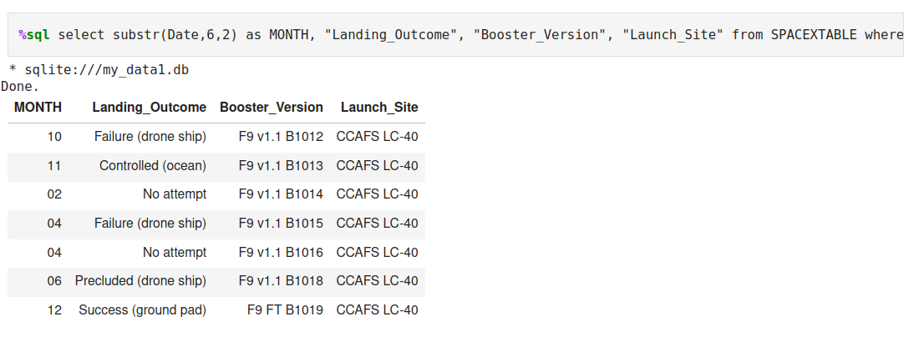
2015 Launch Records
The record of months, landing outcomes, booster versions, and launch sites for 2015 are presented above. Three of these outcomes involved a drone ship- the first, fourth, and sixth in the above image
The SQL query selects desired data from the SPACEXTABLE where the year is 2015.

Slide 34

Section 3

Slide 35
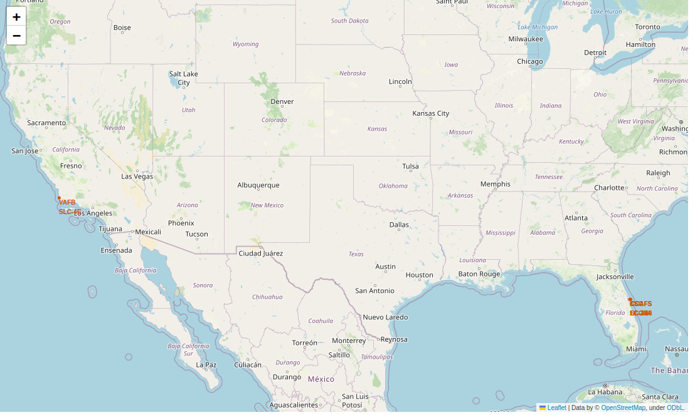
SpaceX Launch Site Map
The image to the right is a folium generated map that shows all SpaceX launch sites .
There are four launch sites present, with three on the east coast of the USA in Florida, and the other in California. All sites are very close to the water as well as several modes of access

Slide 36
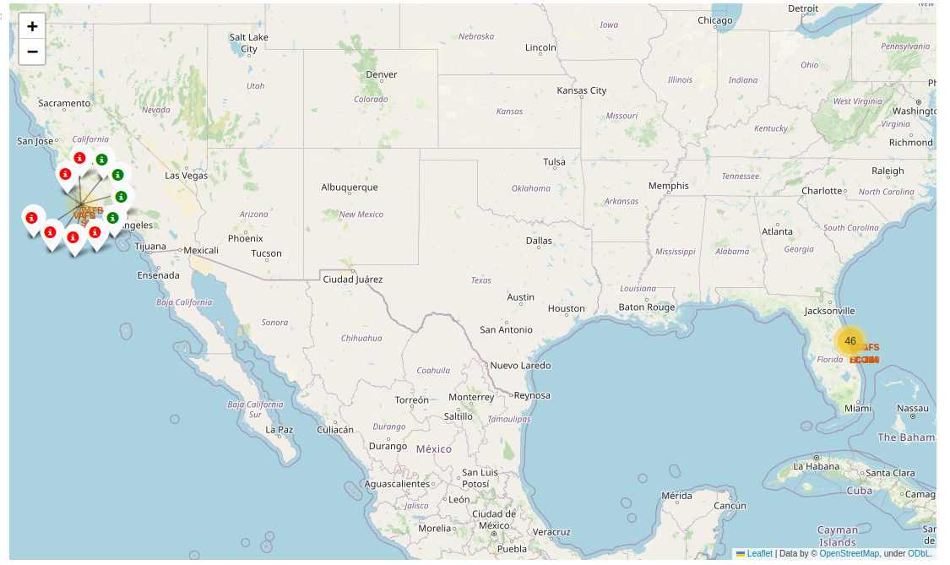
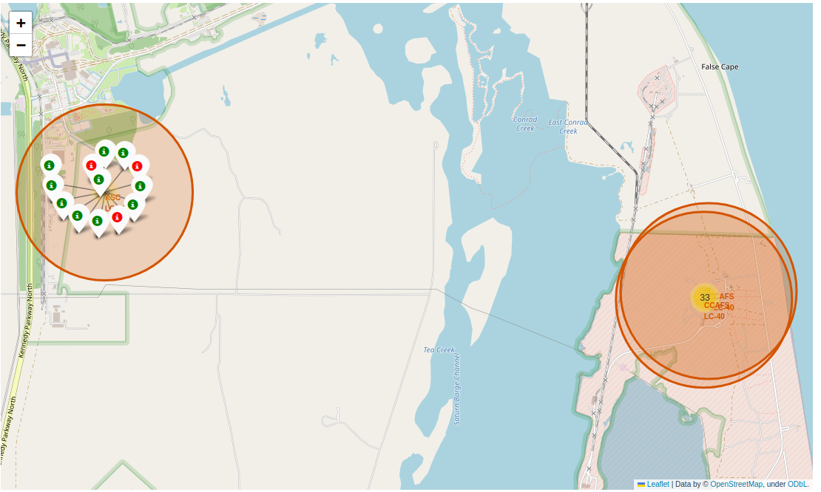
SpaceX Launch Site Outcome Map
In the first map on the right the same launch areas are visible once more, only this time the launch outcomes associated with each site are visible and color coded.
The launch site in California has been clicked on to show color coded outcomes (green for success, red for failure).
The three launch sites in Florida Are clustered closely, but clicking on the right launch sites could zoom in and show the launch clusters for each site. The second map shows one such view.

Slide 37
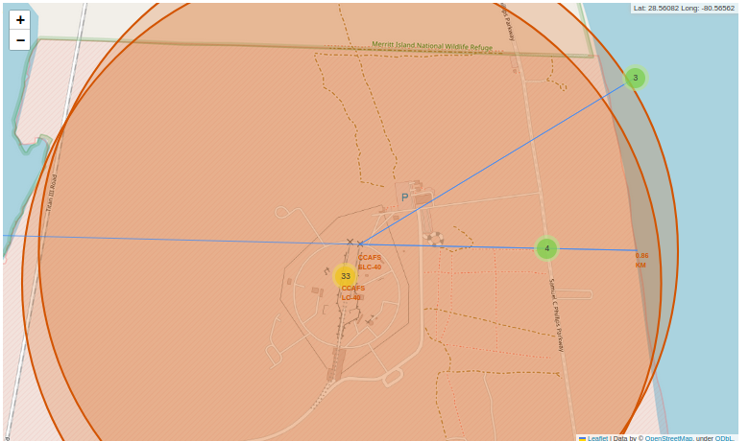
SpaceX Launch Site Proximity Map
The map to the right highlights one example of a launch site's proximity to nearby access methods, coastline, and population centers.
This particular launch site is ~0.86km from the coast, ~0.59km from the nearest highway, ~1.27km from the nearest railway, and ~21.65km from the nearest population center.
These distances imply that there may be some benefit to a launch site being close to the coast, highway, and railway, with city centers kept relatively close but not so close as to be in danger of stray rockets.
In this case, the railway being further away is interesting- the connections are such that deliveries to the site need to be carried by another delivery method that final 1.27km, while the highways come much closer to the actual launch pad.

Slide 38

Section 4

Slide 39
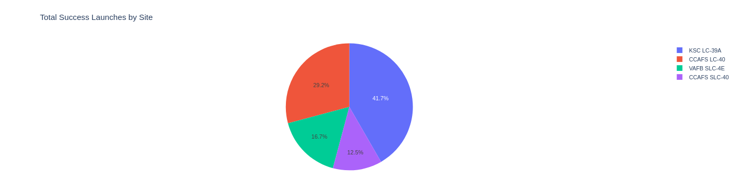
SpaceX Launches by Site
Location matters for a successful landing- only 16.7% occurred on the west coast of the USA- that's four landings. Rockets are typically launched to the east, so a recovery that puts the stage over water is often safer than one that puts it over the continental US.
Of the Florida based launch sites, 41.7%, or 10, of them are from the KSC. This was leased from NASA and benefits from their existing infrastructure and expertise.

Slide 40
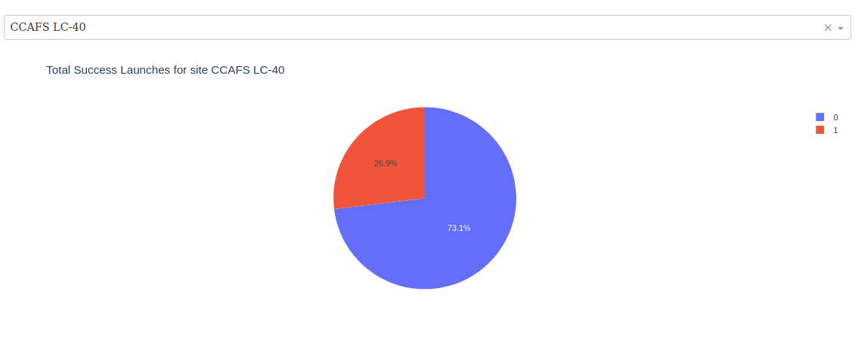
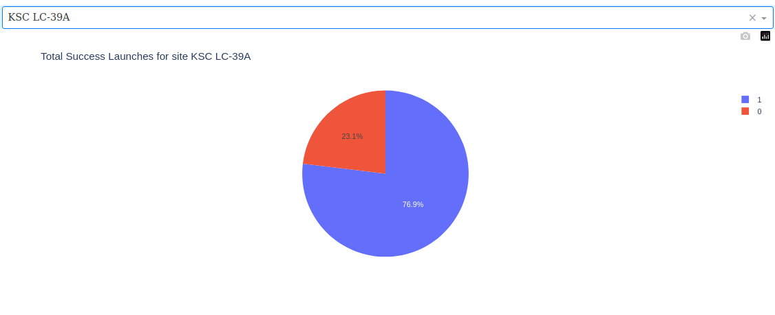
Landing Site Comparison- Best and Worst
As noted on the prior slide, Kennedy Space Center has the best launch site for a successful landing, with 10/13, or 76.9% of the launches leading to a successful landing. While the NASA missions in Florida having a high success rate makes sense, more interestingly the worst success rate site is not the west coast.
CCAFS LC-40 has a lower success rate than VAFB SLC-4E- while it is in Florida, location isn't everything and its 26.9% success rate is substantially worse than the 40% of the west coast site.

Slide 41
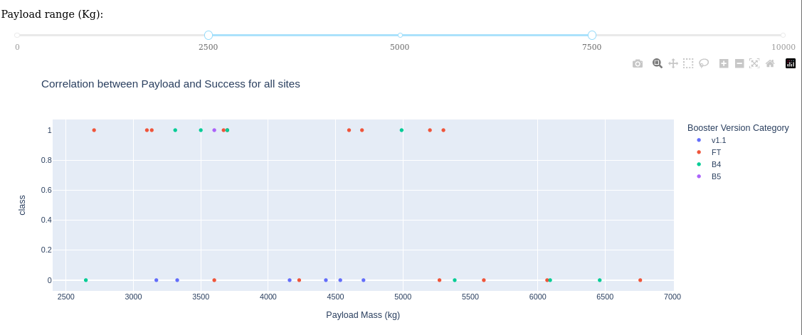
Payload and Landing Success
When excluding the lightest and heaviest payloads from the data range, some rocket versions visibly perform better than others.
The v1.1 rocket has no successful landings in this range, while the B5 has a single launch, a success. B4 is more mixed, with good reliability in lower payloads but no successes past 5000kg.
The FT version is more mixed in its results, but generally has higher success rates for lower payloads.

Slide 42

Section 5

Slide 43
Classification Accuracy
They all had the same accuracy in my tests. Not sure what went wrong here, but the .score method returned 0.8333 for all models.
Maybe the tree is better? Higher in-sample accuracy.
Possibly a bug with the method used, as using .best_estimator_.score(X_test,Y_test) showed Tree as far worse, but the other methods unchanged.

Slide 44
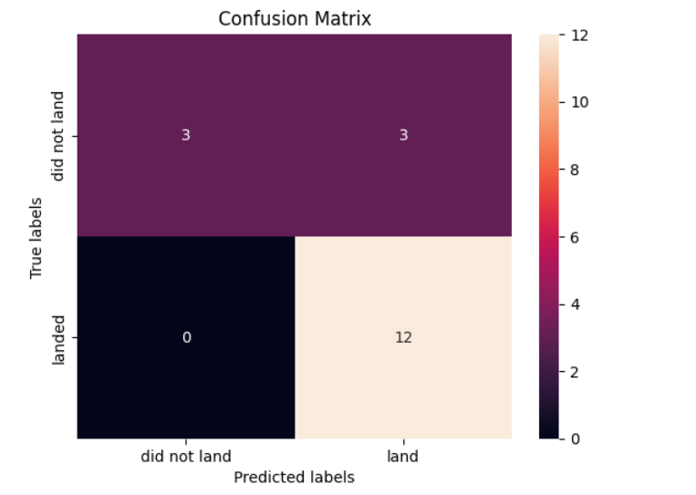
Confusion Matrix
This is the confusion matrix for the "best-performing model", decision tree. Like accuracy they were all the same. Three failed landings were correctly predicted, and three were falsely predicted to be landings. Of the landing predictions, twelve were true and none were false.

Slide 45
Conclusions
Expertise in launching rockets is a massive factor in successful landings- practice really does make a difference (from ~30% during early years of attempts to ~80% later).
Orbit and payload mass also play into success rate- easier to obtain orbits mean smaller rockets, which are generally easier to land. This is carried through with the payload mass, which shows higher success rates with low payloads. The exception to this is low orbits- the two factors can compensate for each other.
Location is key- good infrastructure and proximity to water makes recovery far simpler than trying to land it in a specific spot on land.
Choosing the correct model, and not messing up the score with test data, is key to making accurate predictions.

Slide 46
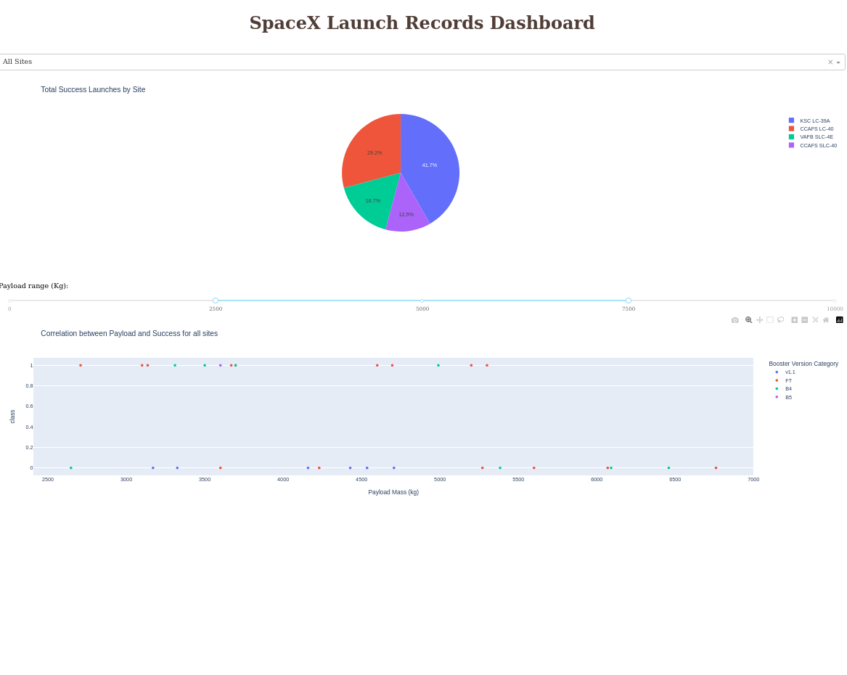
Appendix
In case it was missed, the link to the github database for this presentation is below:
https://github.com/kschofield65/CourseraCapstone
Below is the link to the data used for the launches, for your reference:
https://github.com/kschofield65/CourseraCapstone/blob/main/spacex_launch_dash.csv
To the right is the whole dashboard:

Slide 47

Thank you for the review! Hope your day has been wonderful!

